Slide 1


Slide 2
HOUSING: PRICE PREDICTION
Submitted By:
Sarla Thakur

Slide 3
Problem Statement:
A US-based housing company named Surprise Housing has decided to enter the Australian market.
The company uses data analytics to purchase houses at a price below their actual values and flip them at a higher price. For the same purpose, the company has collected a data set from the sale of houses in Australia.
We are required to build a model using Machine Learning in order to predict the actual value of the prospective properties and decide whether to invest in them or not.

Slide 4
Review of Literature
Houses are one of the necessary needs of each and every person around the globe and therefore housing and real estate market is one of the markets which is one of the major contributors in the world’s economy.
A US-based housing company named Surprise Housing has decided to enter the Australian market. The company uses data analytics to purchase houses at a price below their actual values and flip them at a higher price.
We are required to build a model using Machine Learning in order to predict the actual value of the prospective properties and decide whether to invest in them or not.

Slide 5
Conceptual Background of the domain
Predictive modelling, Market mix modelling, recommendation systems are some of the machine learning techniques used for achieving the business goals for housing companies.
Hedonic Characteristics of Housing Price: A Hedonic approach is preferred for predicting the sale prices in the housing market because the market displays resilience, flexibility and spatial fixity.
Housing Attributes: Studying the structural, locational, and economic attributes of housing properties is crucial in understanding their mutually inclusive relationships with their pricing.

Slide 6
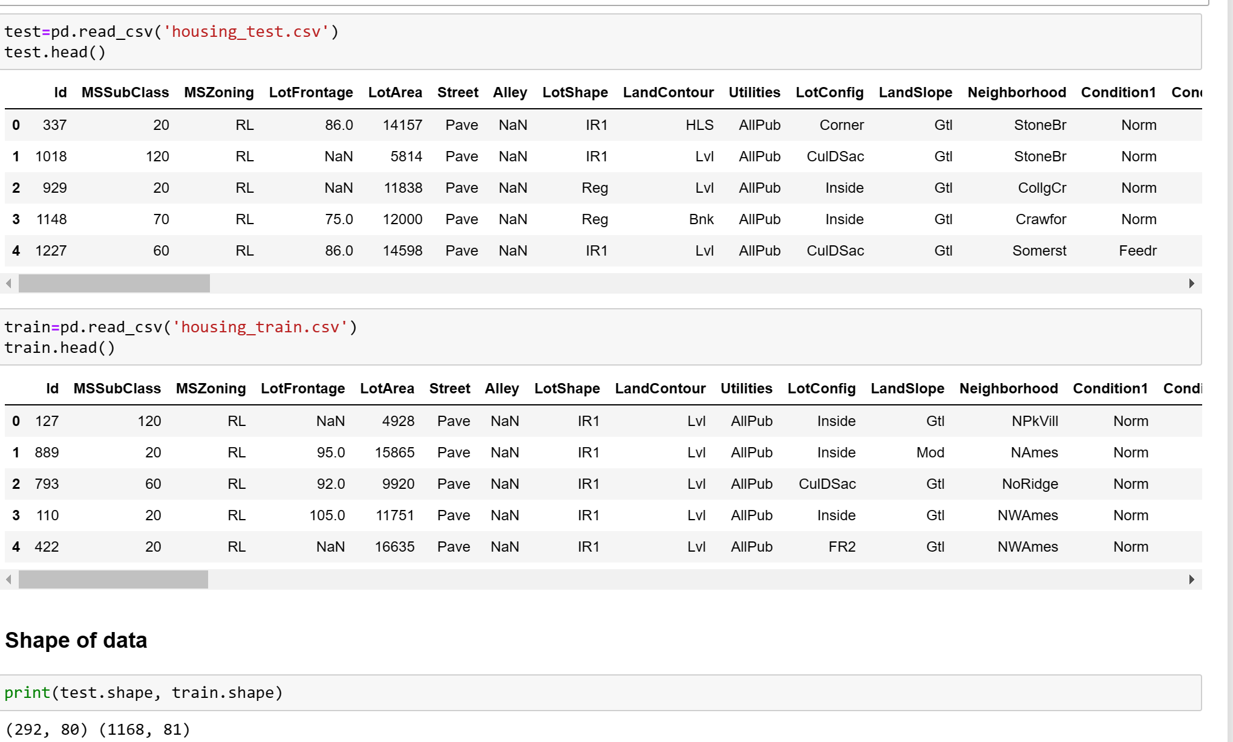

Slide 7
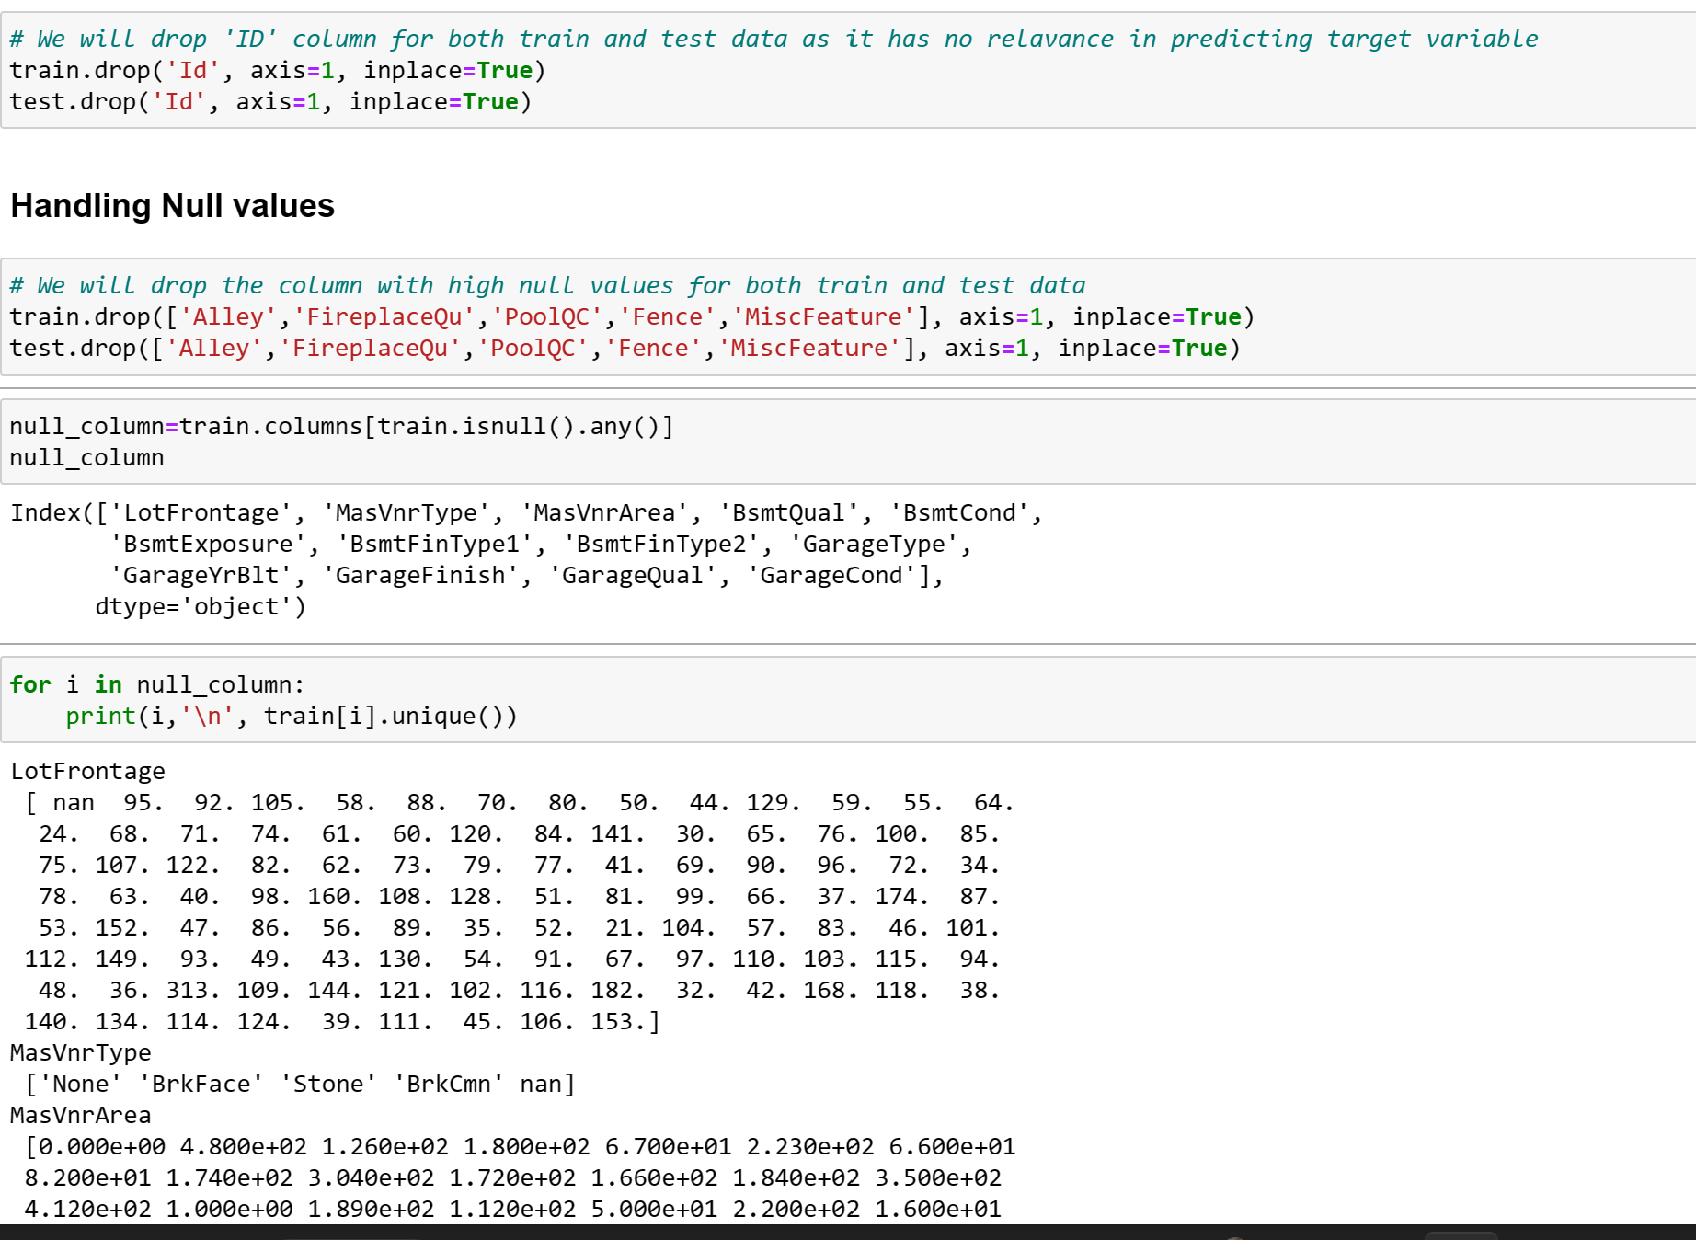
Data Cleaning

Slide 8
EDA(Exploratory data analysis):
Exploratory Data Analysis (EDA) is an approach of analyzing data sets to summarize their main characteristics, often with visual methods, a statistical model can be used or not, but primarily EDA is for seeing what the data can tell us beyond the formal modelling or hypothesis testing task. we can say that EDA is statisticians’ way of storytelling where you explore data, find patterns and tell insights. EDA is a phenomenon under data analysis used for gaining a better understanding of data aspects like: - main features of data variables and relationships that hold between them identifying which variables are important for our problem.

Slide 9
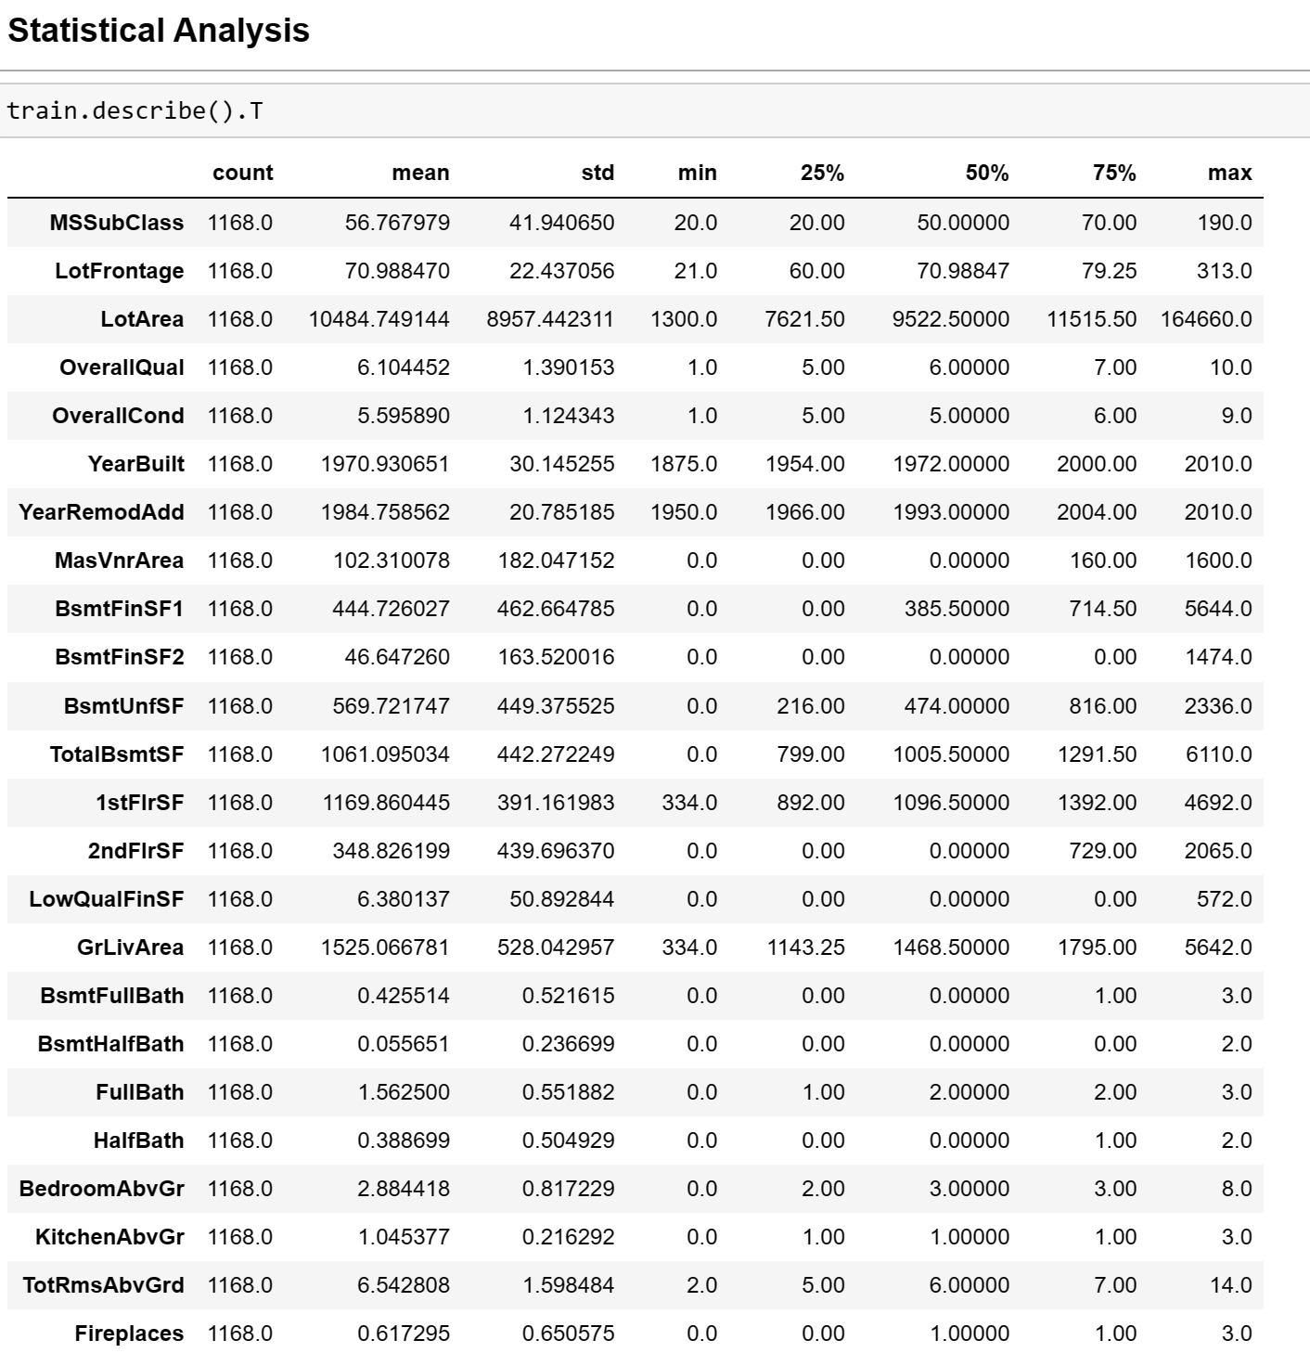
STATISTICAL INFORMATION

Slide 10
Data Cleaning Steps:
Checking Missing values
Dropping columns & imputation accordingly
Applying z score on outliers
Handling Skewness
PCA

Slide 11
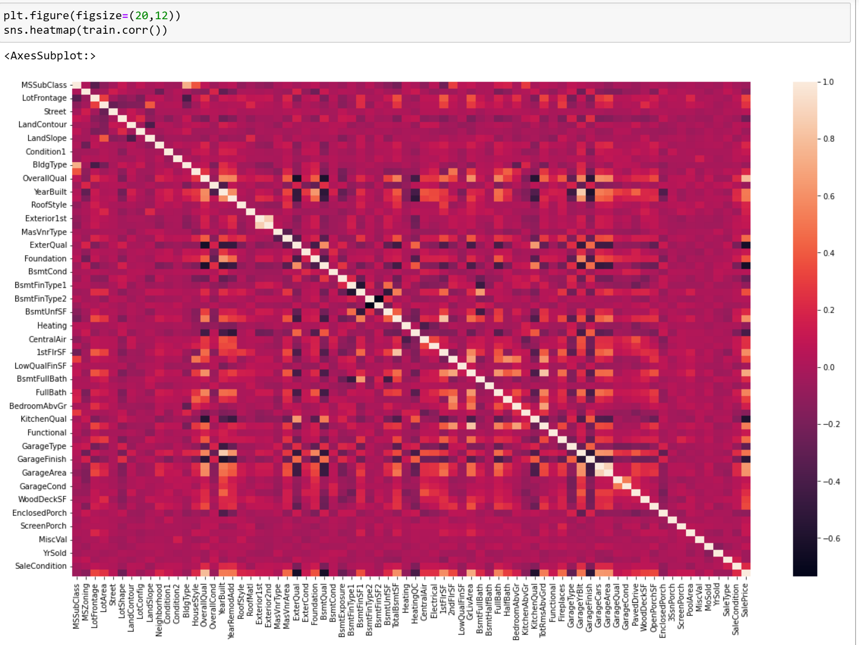
DATA INPUTS- LOGIC- OUTPUT RELATIONSHIPS

Slide 12
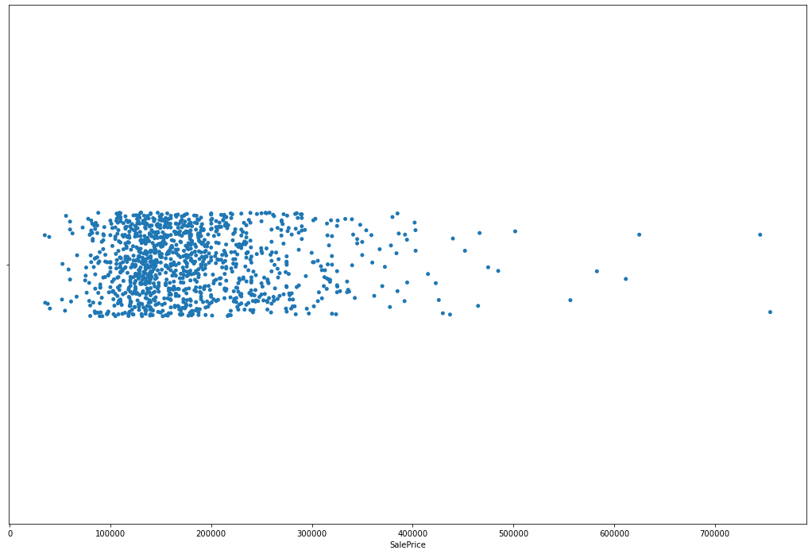
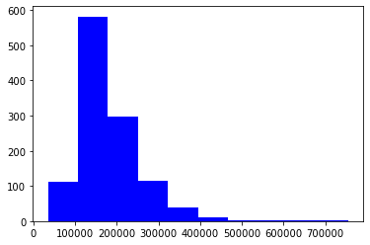
PLOT of the Target Variable

Slide 13
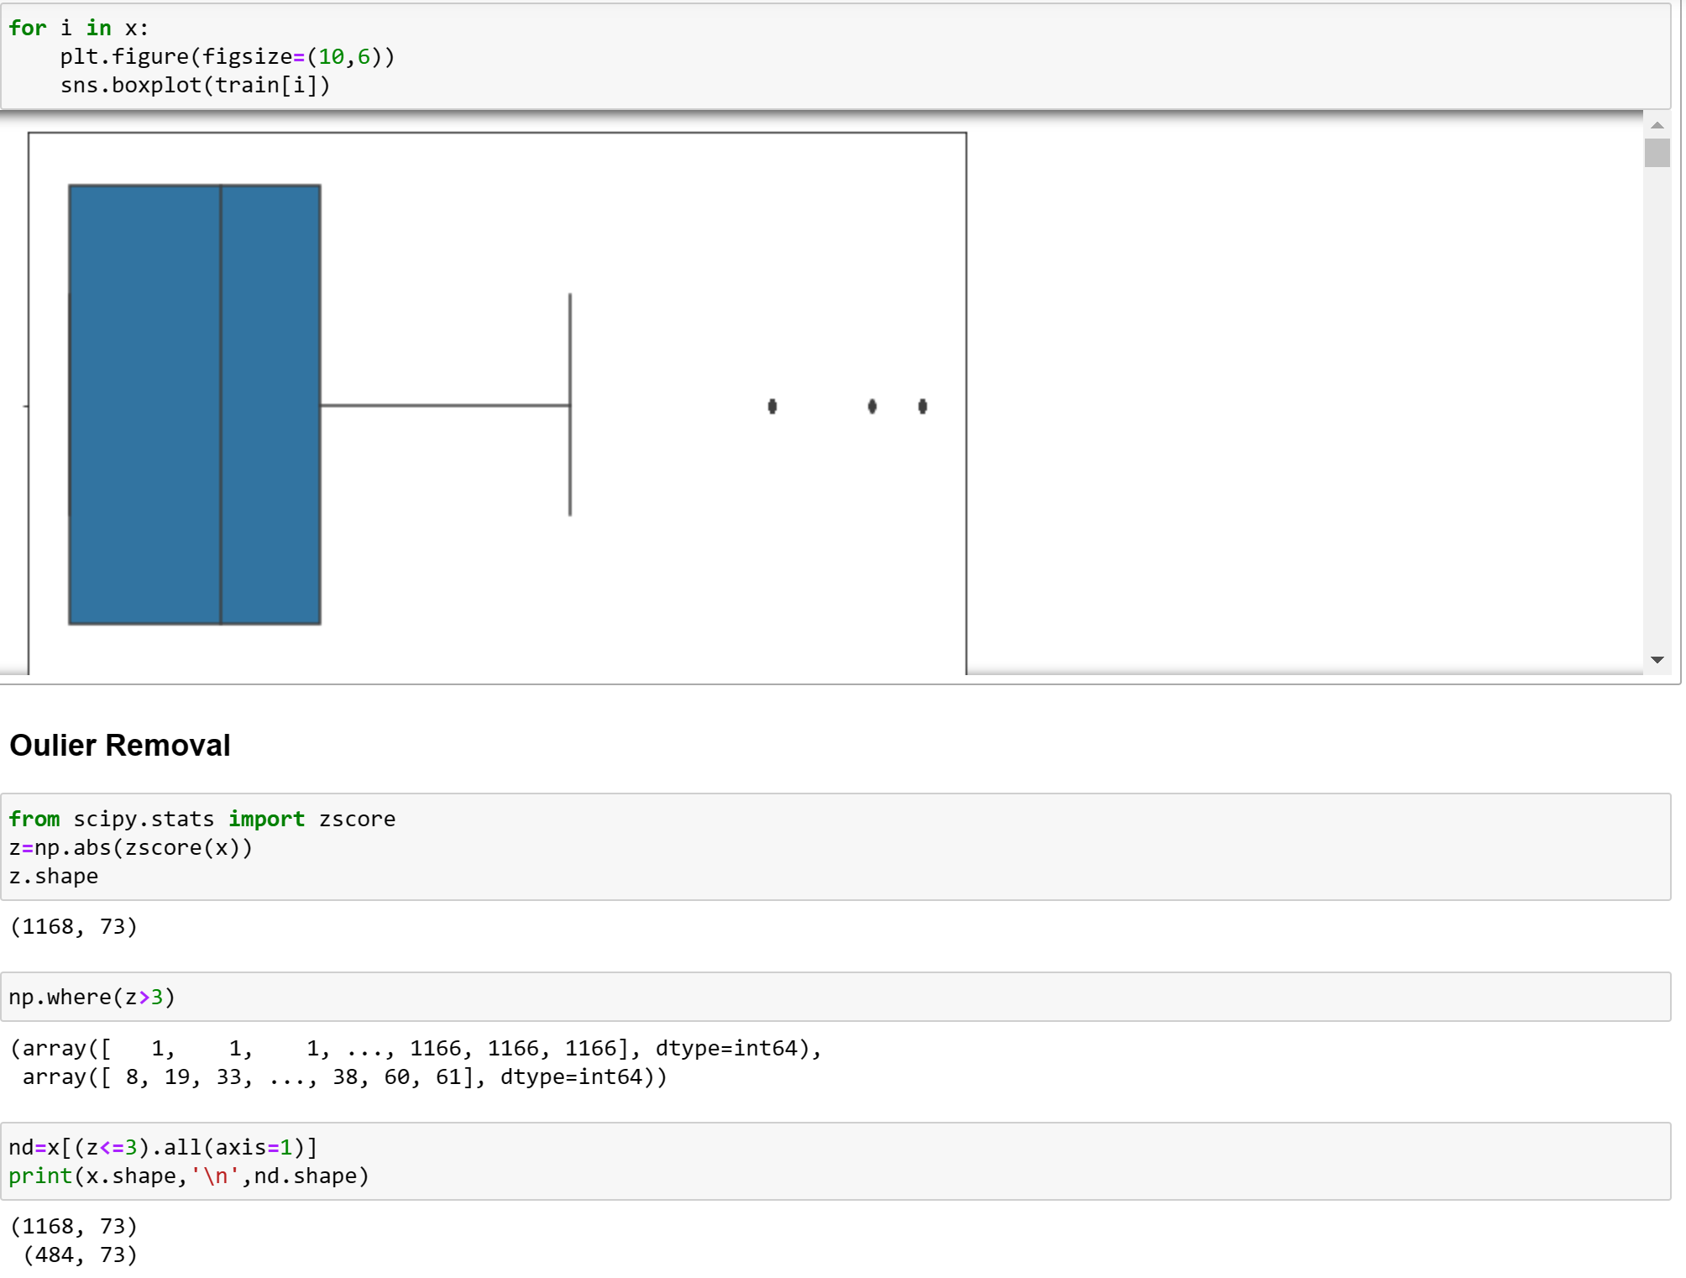
PLOTTING OUTLIERS

Slide 14
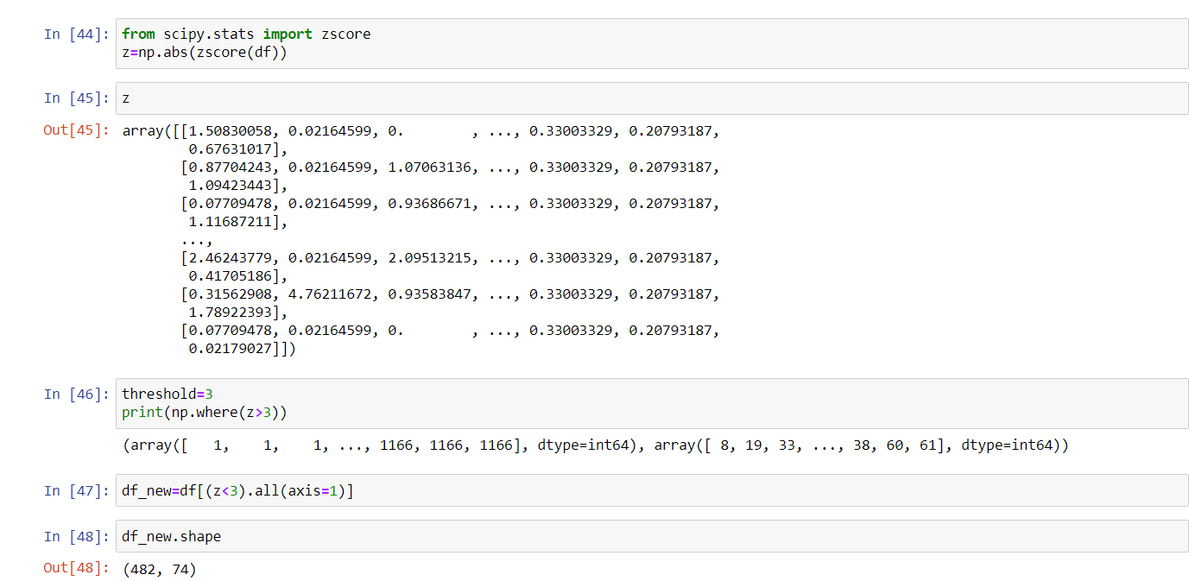
Removing the Outliers using Z-score

Slide 15
Models DevelopmenT anD Evaluation
Identification of possible problem-solving approaches (methods)
We have performed various mathematical and statistical analysis such as we checked description or statistical summary of the data using describe, checked correlation using corr and also visualized it using heatmap. Then we have used zscore to plot outliers. We have used distplot to find the distribution of all attributes.

Slide 16
Testing of Identified Approaches (Algorithms)
We have used following algorithms such as: Linear Regression, Lasso, Ridge, SVR, Decision Tree Regressor, Kneighbors Regressor, Random Forest Regressor,

Slide 17
Run and Evaluate selected models
We have formed a loop where all the algorithms will be used one by one and their corresponding Score, Mean Absolute Error, Mean Squared Error, RMSE and r2_score will be evaluated.
I chose Ridge as our best model since it's giving us best score and it's performing well. It's r2_score is also satisfactory and it shows that our model is neither underfitting/overfitting.
Hence we saved Ridge as our final model using pickle.

Slide 18
Key Metrics for success in solving problem under consideration
Key metrics used for finalising the model was Cross Validation Score and r2_score. Since in case of Ridge it's giving us good score among all other models and it's performing well. It's r2_score is also satisfactory and it shows that our model is neither underfitting/overfitting .

Slide 19
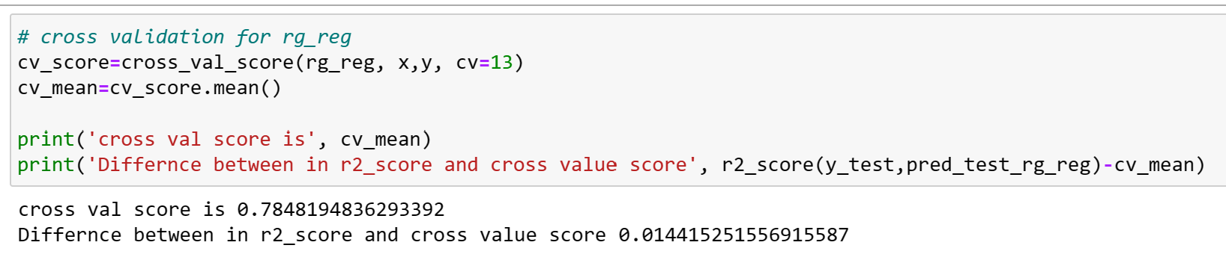
Cross Validation Score

Slide 20
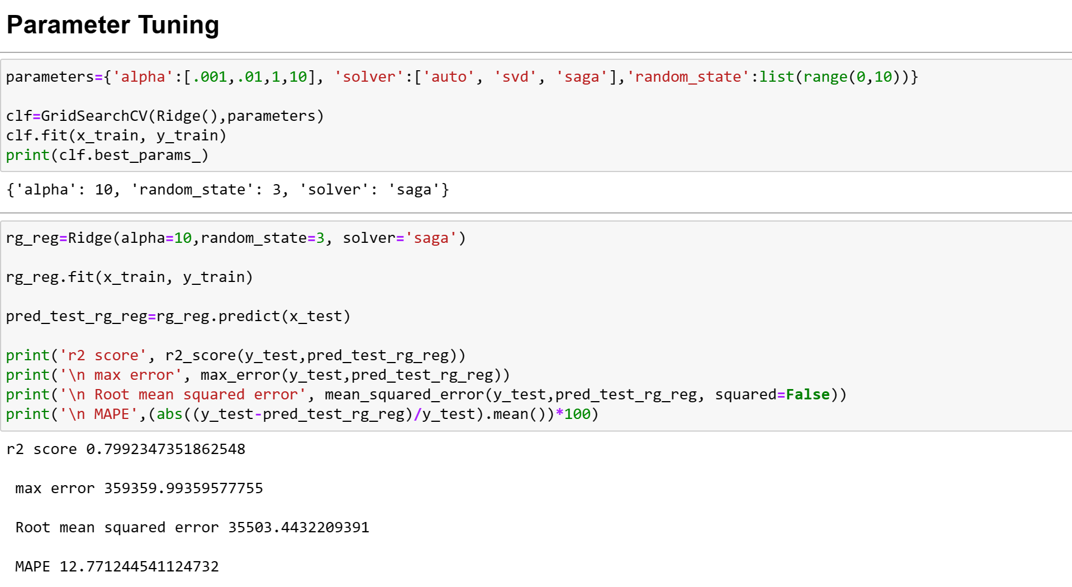
HYPERPARAMETER TUNING

Slide 21
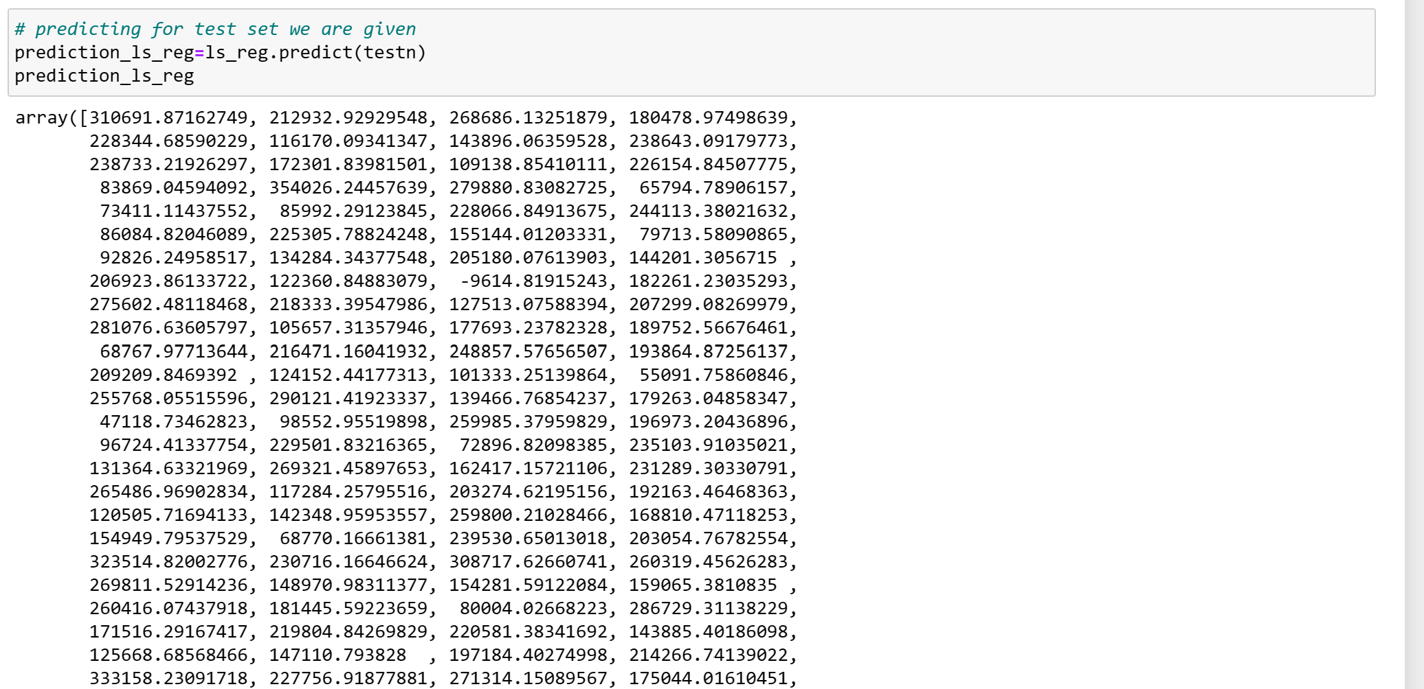
MAKING PREDICTIONS

Slide 22
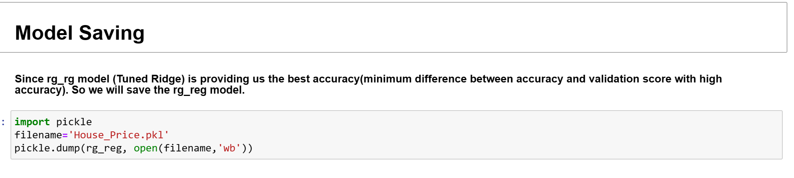
SAVING MODEL

Slide 23
Conclusion
Landconotur corresponding to 1 i.e, HLS Hillside - Significant slope from side to side has maximum price.
Neighborhoot with (15)NPkVill Northpark Villa has maximum sales price and (10)IDOTRR Iowa DOT and Rail Road has least.
1Fam Single-family Detached and TwnhsI Townhouse Inside Unit have maximum saleprice.
In HouseStyle category 3: 2Story Two story has max sale price.
In RoofStyle 5:Shed has maximum.
In Exterior1st 6:HardBoard and 9:Other have Saleprice
In MasVnrType, 3:stone has max saleprice and 0:BrkCmn Brick Common has least
Houses with CentralAir has higher saleprice
GarageType 3:BuiltIn Built-In (Garage part of house - typically has room above garage) has max saleprice
In 2007 maximum houses are sold followed by 2006
MSSubClass,OverallCond,KitchenAbvGr,EnclosedPorch and Yr Sold are the least/negatively correlated column with target('SalePrice') variable
OverallQual is highly correlated column with target variable followed by GrLivArea and other attributes.

Slide 24
Limitations of this work and Scope for Future Work
While we couldn’t reach out goal of minimum RMSE in house price prediction without letting the model to overfit, we did end up creating a system that can with enough time and data get very close to that goal. As with any project there is room for improvement here. The very nature of this project allows for multiple algorithms to be integrated together as modules and their results can be combined to increase the accuracy of the final result. This model can further be improved with the addition of more algorithms into it. However, the output of these algorithms needs to be in the same format as the others. Once that condition is satisfied, the modules are easy to add as done in the code. This provides a great degree of modularity and versatility to the project.

Slide 25
THANK YOU

